Slide 1
Edu Vision-WiTrack:Secure Attendance with Visual Lock
CSE7101- Capstone Project
Review-3
Batch Number: IST_04
ROLL NUMBER STUDENT NAME
20221IST0023 G DHANUSH
20221IST0004 ANOOP KUMAR
20221IST0006 NAVYA B
Under the Supervision of,
Dr.Poornima S
Professor / Associate Professor / Assistant Professor
School of Computer Science and Engineering
Presidency University
Name of the Program: Information Science and Technology(spl in Artificial Intelligence and Data Science)
Name of the HoD: Dr.Pallavi R
Name of the Program Project Coordinator: Mrs.Benitha Christinal J
Name of the School Project Coordinators: Dr. Sampath A K , Dr. Geetha A

Slide 2
Content
Problem Statement
Objectives
System Architecture
WorkFlow/ System Flow Chart
Algorithm Design
Module Description
Implementation Status
Literature Review
Challenges & Future steps

Slide 3
Problem Statement Number: 582
Problem Description:
Manual attendance methods are slow, inaccurate, and easily manipulated.
Existing digital systems depend only on Wi-Fi or only on face recognition, allowing spoofing, proxy attendance, and mismatches.
To solve this, we propose an AI-based dual validation system combining camera headcount + WiFi IP logs.

Slide 4
Objectives
Automate attendance with AI vision + WiFi authentication.
Eliminate proxy attendance and device sharing.
Reduce time taken for classroom attendance.
Provide real-time accuracy and alert mechanisms.
Store logs for monitoring and reporting.

Slide 5
System Architecture
The architecture of EduVision-WiTrack is layered:
Extract device logs from Wi-Fi access pointsCamera Module – Capture classroom video frames
Camera Module: Record video frames in the classroomMatching Engine – Compare device count with headcount
Visual Processing Unit: Identify and tally residentsFirebase Cloud Functions – Real-time automation
Matching Engine: Compare the number of devices and the number of peopleAdmin Panel – Device registration, session creation
Firebase Firestore: Save alerts and session logs
Firebase Cloud Functions: Automation in real time
Dashboard Interface: Faculty accessAdmin Panel: Creating sessions and registering devices

Slide 6
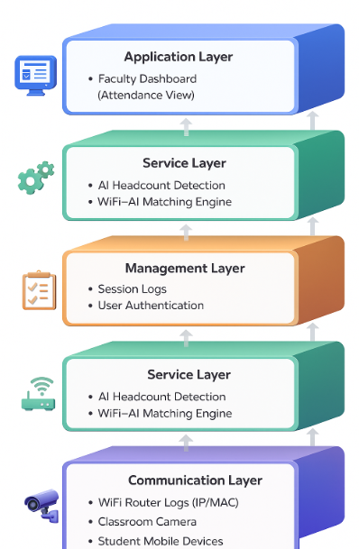
System Architecture

Slide 7
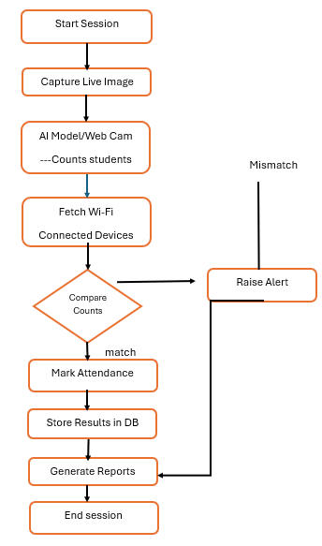
Workflow / System Flowchart
Steps:
Start Session
Capture Live Classroom Image
Run AI Model → Detect students
Extract WiFi connected devices
Compare counts
If Match → Mark Attendance
If Mismatch → Raise Alert
Store results
End Session

Slide 8
Algorithm Design
START
Capture classroom image
Head_Count ← Detect students in image
IP_Count ← Get number of connected devices
IF Head_Count = IP_Count THEN
Mark Attendance
ELSE
Raise Mismatch Alert
END IF
Save results to database
END

Slide 9
Module description table
Module | Description | Status
Camera Capture | Captures live frame | ✔ Working
AI Detection | Identifies & counts students | ✔ Working
WiFi Log Reader | Fetches active devices | ✔ Working
Matching Engine | Compares both counts | ✔ Partial
Dashboard | Attendance display | In Progress

Slide 10
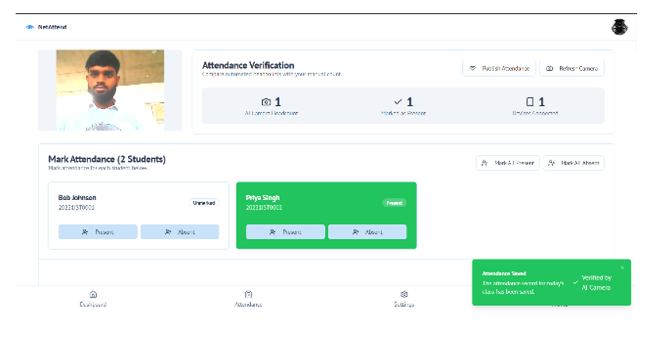
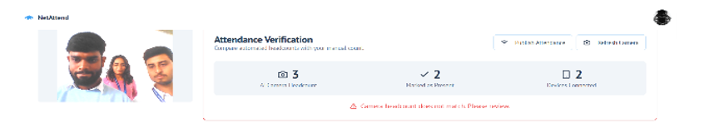
Implementation Status (Live Demo 50%)
Working now:
AI headcount model
Live frame detection
WiFi connected device extraction
Matching logic (test mode)
Demo Screenshots:
Student detection image
WiFi logs table
Match/Mismatch result

Slide 11
Literature Review
Year | Authors | Method | Findings | Gap
2021 | Alburaiki et al. | GPS + Face | Indoor inaccuracy | Needs better validation
2020 | Hashmi | MAC-based WiFi | Auto logging | No physical presence
2021 | Shene | WiFi/Bluetooth | Privacy model | No headcount

Slide 12
Challenges & Future Steps
Challenges
Improve AI accuracy
Create full web dashboard
Optimize WiFi data filtering
Build final attendance reports
Integrate full end-to-end automation
Future Steps
Different lighting & angles affect AI detection
Students with multiple devices
WiFi spoofing / shared hotspot
Integration of two modules
Real-time processing delays

Slide 13


